Slide 1
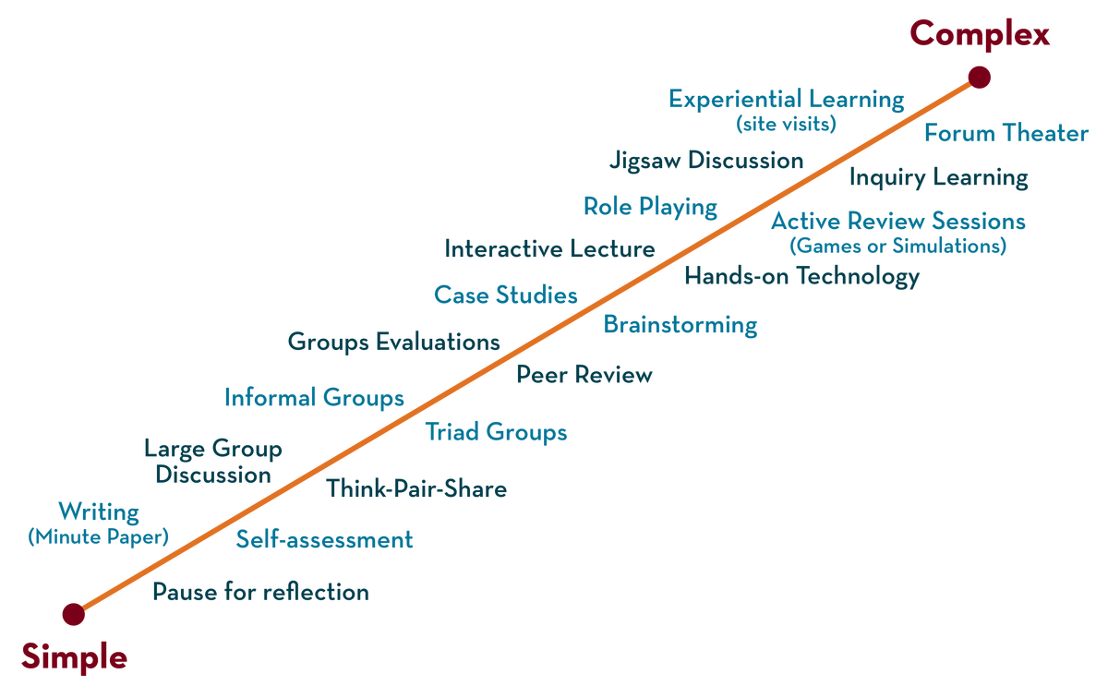
COURSE NAME : Operating Systems COURSE CODE: 21CS2109RA
CO2
Session - 3
DEMAND PAGING, FREE SPACE MANAGEMENT, TRANSLATION LOOK ASIDE BUFFER, THRASHING

Slide 2
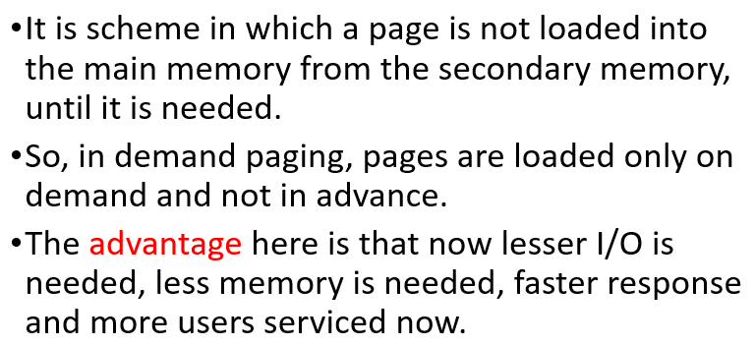
WHAT IS DEMAND PAGING ?

Slide 3
PURE DEMAND PAGING
Pure Demand paging is the form of demand paging in which not even a single page is loaded into memory Initially.
Therefore, the very first instance instruction cause a page fault in this case.
This type of demand paging may significantly decrease the performance of a computer system by generally increasing the effective access time of memory.

Slide 4
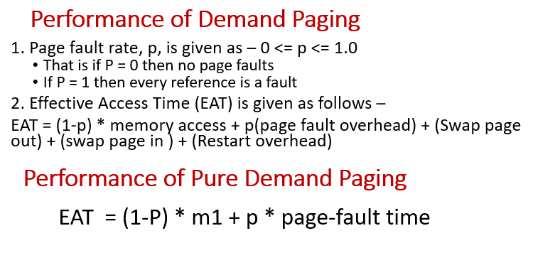
PERFORMANCE OF DEMAND PAGING

Slide 5
Gate Problem on Performance of Demand Paging
QUESTION:
Suppose we have a demand-paged memory. The page table is held in registers. It take 8 milliseconds to service a page fault if an empty page is available or the replaced page is not modified and 20 milliseconds if the page replaced is modified. Memory access time is 100 nanoseconds. Assume that the page to be replaced is modified 70 percent of time. What is the maximum acceptable page-fault rate for an effective access time of no more than 200 nano seconds?

Slide 6
SOLUTION :
From the given conditions, we get
0.2 µs = (1-p) * (0.1 µs + (0.3P) * 8 milli sec + (0.7P) * 20 millisec.
Or 1 = -P +2400 P + 14000 P [ since 100 ns =0.1 µs & 200 ns = 0.2 µs ]
Or 1 = 16399P
Or P = 0.00006

Slide 7
Gate Problem on Performance of Demand Paging
QUESTION:
Consider a demand paging system with a paging disk that has an average access and transfer time of 20 milliseconds.
Addresses are translated through a page table in main memory with an access time 1 microsecond per memory access. Thus, every reference through the page table takes two accesses. To improve this time, we have added an associate memory that reduces access time to one memory reference, if the page-table entry is in the associative memory.
Assume that 80 percent of the accesses are in the associative memory and that, of the remaining 10 percent (or 2 percent of the total ) causes page faults. What is the Effective Memory Access Time ?

Slide 8
SOLUTION
Solution:
Effective Access Time (EAT) = (0.8) (1 sec) + (0.1)(2 sec) + (0.1) (5002 sec)
= 501.2 sec
= 0.5 milliseconds

Slide 9
Free Space Management
A file system is responsible to allocate the free blocks to the file therefore it has to keep track of all the free blocks present in the disk. There are mainly two approaches by using which, the free blocks in the disk are managed.
1. Bit Vector
In this approach, the free space list is implemented as a bit map vector. It contains the number of bits where each bit represents each block.
If the block is empty then the bit is 1 otherwise it is 0. Initially all the blocks are empty therefore each bit in the bit map vector contains 1.
As the space allocation proceeds, the file system starts allocating blocks to the files and setting the respective bit to 0.

Slide 10
Free Space Management
2. Linked List
It is another approach for free space management. This approach suggests linking together all the free blocks and keeping a pointer in the cache which points to the first free block.
Therefore, all the free blocks on the disks will be linked together with a pointer. Whenever a block gets allocated, its previous free block will be linked to its next free block.

Slide 11
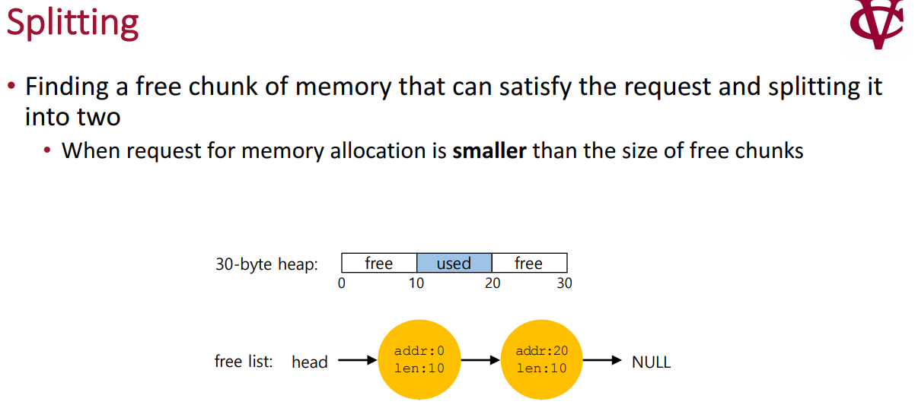

Slide 12
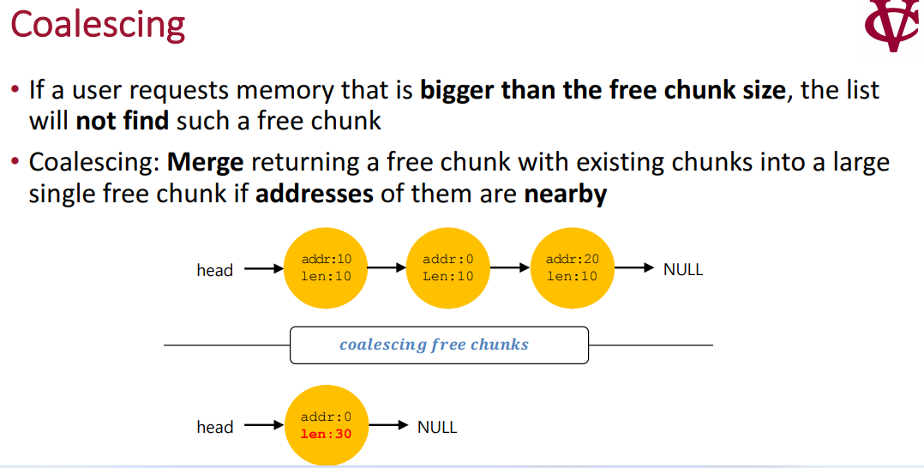

Slide 13
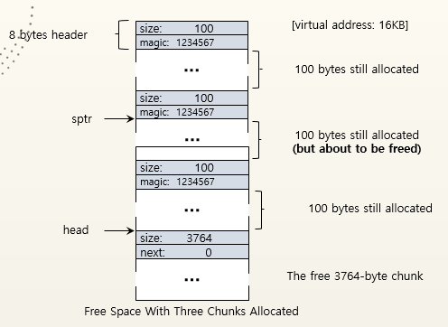
Free Space With Chunks Allocated

Slide 14
Free Space With free()
The 100 bytes chunks is back into the free list.
The free list will start with a small chunk.
The list header will point the small chunk
The free() function is used to deallocate memory while it is allocated using malloc(), calloc() and realloc().
The syntax of the free is simple. We simply use free with the pointer. Then it can clean up the memory.

Slide 15
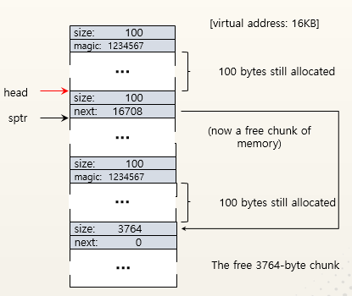
Free Space With free()

Slide 16
Translation Look Aside Buffer
A translation look aside buffer (TLB) is a memory cache that stores recent translations of virtual memory to physical addresses for faster retrieval.
When a virtual memory address is referenced by a program, the search starts in the CPU. First, instruction caches are checked.
If the required memory is not in these very fast caches, the system has to look up the memory’s physical address.
At this point, TLB is checked for a quick reference to the location in physical memory.

Slide 17
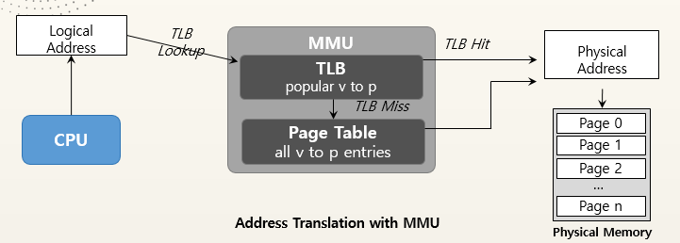
Part of the chip’s memory-management unit(MMU).
A hardware cache of popular virtual-to-physical address translation.

Slide 18
Translation Look Aside Buffer
When an address is searched in the TLB and not found, the physical memory must be searched with a memory page crawl operation.
As virtual memory addresses are translated, values referenced are added to TLB.
When a value can be retrieved from TLB, speed is enhanced because the memory address is stored in the TLB on processor.
Most processors include TLBs to increase the speed of virtual memory operations through the inherent latency-reducing proximity as well as the high-running frequencies of current CPU’s.

Slide 19
Translation Look Aside Buffer
TLBs also add the support required for multi-user computers to keep memory separate, by having a user and a supervisor mode as well as using permissions on read and write bits to enable sharing.
TLBs can suffer performance issues from multitasking and code errors. This performance degradation is called a cache thrash.
Cache thrash is caused by an ongoing computer activity that fails to progress due to excessive use of resources or conflicts in the caching system.

Slide 20
Thrashing
If the number of frames allocated to a low-priority process falls below the minimum number then we must suspend that process execution.
We should then page out its remaining pages, freeing all its allocated frames.
So, now swapping is required. We can find some process in a system that does not have “enough” frames.
It is technically possible to reduce the number of allocated frames to the minimum, there is some(larger) number of pages in active use.

Slide 21
Thrashing
If the Process does not have this number of frames then it will quickly page fault again and again.
The process continues to fault, replacing pages for which It then faults and brings back in right away. Such a process spend more time in paging than executing.
This high paging activity is called as Trashing. A process is said to be trashing if it is spending more time in paging then in execution.

Slide 22
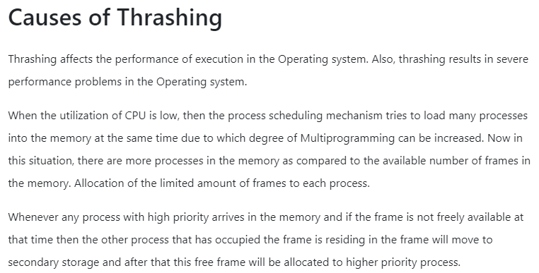

Slide 23
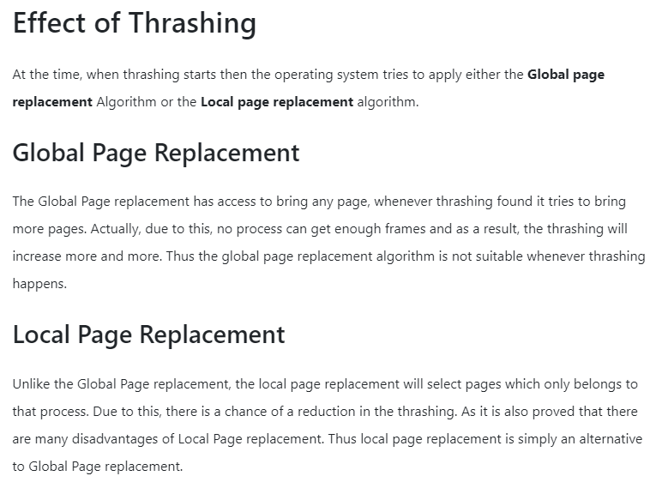
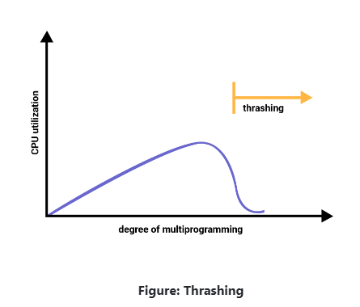

Slide 24
SUMMARY
Demand paging is a process of swapping in the Virtual Memory system. In this process, all data is not moved from hard drive to main memory because while using this demand paging, when some programs are getting demand then data will be transferred. But, if required data is already existed into memory then not need to copy of data. The demand paging system is done with swapping from auxiliary storage to primary memory, so it is known as “Lazy Evaluation”.
Example of Demand Paging Memory Access Time = 200 nanoseconds Average Page Fault Service Time = 8 milliseconds EAT = (1-p)*200+p (8 milliseconds) = (1-p)*200+p*8000000 = 200+p*7999800 EAT means direct proportional to the page fault rate.

Slide 25
SUMMARY
A translation lookaside buffer (TLB) is a memory cache that stores recent translations of virtual memory to physical addresses for faster retrieval. When a virtual memory address is referenced by a program, the search starts in the CPU. First, instruction caches are checked. If the required memory is not in these very fast caches, the system has to look up the memory’s physical address. At this point, TLB is checked for a quick reference to the location in physical memory.
High paging activity is called as Trashing. A process is said to be trashing if it is spending more time in paging then in execution.

Slide 26
TERMINAL QUESTIONS
What is Demand Paging and Pure Demand Paging ?
Explain the procedure to Calculate the Performance of Demand Paging and Pure Demand Paging
Describe Translation Look Aside Buffer with the help of block diagram.
Explain different procedures adopted in Free Space Management.
Define Thrashing and Explain the Causes for Thrashing, and give the effect of Thrashing.
Suppose we have a demand-paged memory. The page table is held in registers. It take 8 milliseconds to service a page fault if an empty page is available or the replaced page is not modified and 20 milliseconds if the page replaced is modified. Memory access time is 100 nanoseconds. Assume that the page to be replaced is modified 70 percent of time. What is the maximum acceptable page-fault rate for an effective access time of no more than 200 nano seconds?

Slide 27
Replace a page that has not been used for the longest period of time is the criteria of which of these algorithms
FIFO
LRU
Optimal
None of the above
Replace a page that is the oldest page of all the pages of main memory?.
FIFO
LRU
Optimal
None of the above

Slide 28
REFERENCES FOR FURTHER LEARNING OF THE SESSION
Reference Books:
1. Arpaci-Dusseau, Remzi H., and Andrea C. Arpaci-Dusseau. Operating systems: Three easy pieces. Boston: Arpaci-Dusseau Books LLC, 2018. http://pages.cs.wisc.edu/~remzi/OSTEP/
Silberschatz, Abraham, Peter B. Galvin, and Greg Gagne. Operating system concepts. 10th edition, John Wiley & Sons, 2018.
Tanenbaum, Andrew. Modern operating systems. Pearson Education, Inc., 2009.
Sites and Web links:
https://www.cse.iitb.ac.in/~mythili/os/
https://cse.iitkgp.ac.in/~sumantra/courses/os/os_pg.html
https://www.cse.iitd.ernet.in/os-lectures

Slide 29

THANK YOU
Team – Operating System

